Slide 1
Welcome to East2West
Walking from the east to the west

Slide 2
i.Introduction
East2West Tours and Travels is a young and dynamic company run by dedicated professional’s committed to providing the highest standards of service to the travel industry. We place great emphasis on personalized service, meticulous attention to detail, innovative itineraries and excellent customer care. However, over the years, there have been few difficult situations or queries, which we have not been able to solve and look forward to improve upon in the future. We are on call, at your service, 7 days a week. Our rates are highly competitive, and if you are seeking a travel agency who can not only provide top quality service, but can also anticipate and fully understand your needs, then look no further.

Slide 3
II. East2West Tours and Travels
1. Package Tours
Each package is characterized by a fixed duration and one whole price. Each component is not charged separately.
We are in industry for the past 10 years. This experience enables us to create packages, which could become popular. We also get our data leads from past records.
In the present system, when a customer comes to us for a complete holiday package, we show them the available package tours. The customer makes a selection and we book the customer for that package. Normally, the package rates are specified on a per person basis. Therefore, the amount to be charged is calculated depending on the number of tickets purchased. Hence, the manual system is very slow, as displaying the various package brochures, entering customer data and making the sales entry is time consuming and involves multiple books. Hence, the proposal is to build an alternate system that will quicken this process.

Slide 4
II. East2West Tours and Travels
2. Car Rental Service
Secondly, we also rent out cars. Sometimes customers already have a plan of travel with them and only need conveyance from us.
We have many models of cars like Honda, Hyundai, Tata, Maruti and Toyota and various types like small size, full size, luxury and minivan.
In the present system, when the customer comes to rent a car, a list of cars fitting into the customer’s requirements is displayed. The customer makes a selection and we book the car for that customer. Finding the appropriate car and making the sales entry is time consuming and involves multiple books.
The above two services are billable. However, cancellations are possible. The refund is calculated based on the number of days remaining before the actual use of the service.

Slide 5
II. East2West Tours and Travels
3. Information Desk
This is the third service, which is a non-profit service, but we see it as an opportunity-yielding service for us. We have huge and growing database of hotels and flights. We have organized them city-wise. Customers, who already have decided the place they have to travel to, might be interested in finding out detailed information about the various hotels and flights for that place. Our information desk enables them to have access to such information like hotels, their rates, facilities offered by them, cuisines they specialize in and the flights available to that city, its timings, its schedule and cost. This information desk is highly popular for it is non-billable. In the present system, this information is stored in brochures and static records. However, we have plans to automate the data storage and retrieval systems.

Slide 6
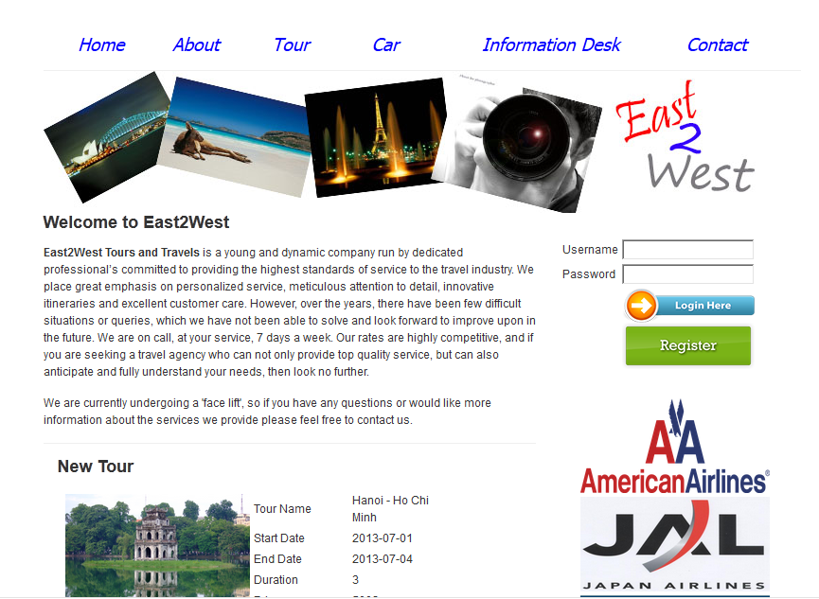
Home page
Provides many thing such as search function, book function, view detail function

Slide 7
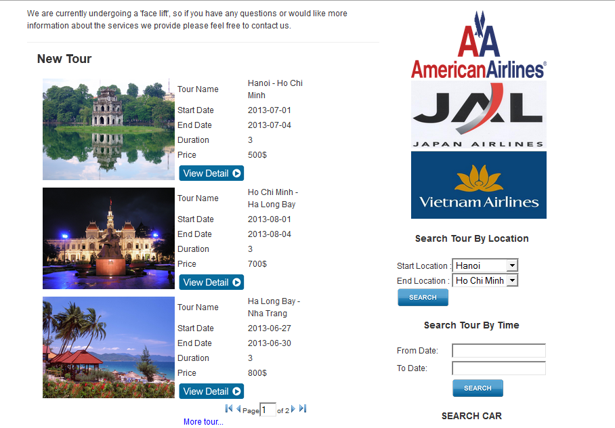
Home Page

Slide 8
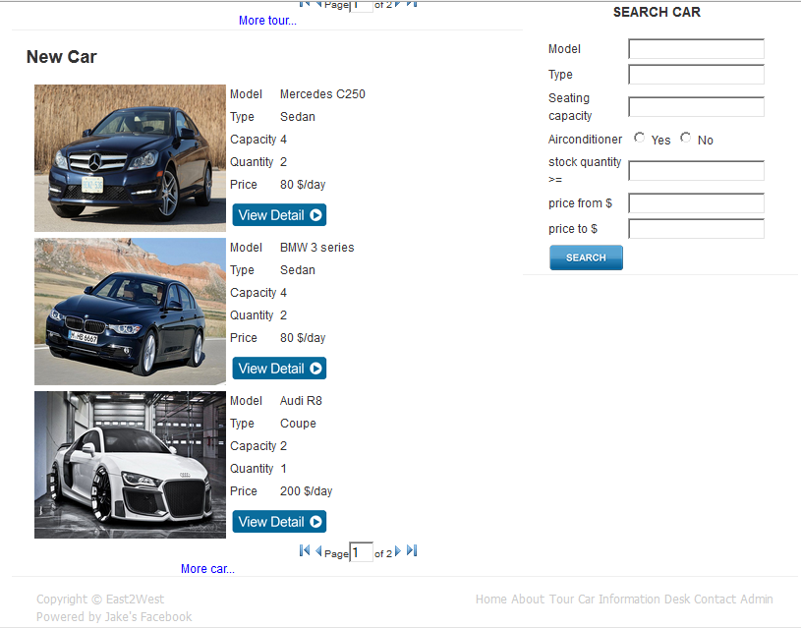
Home page

Slide 9
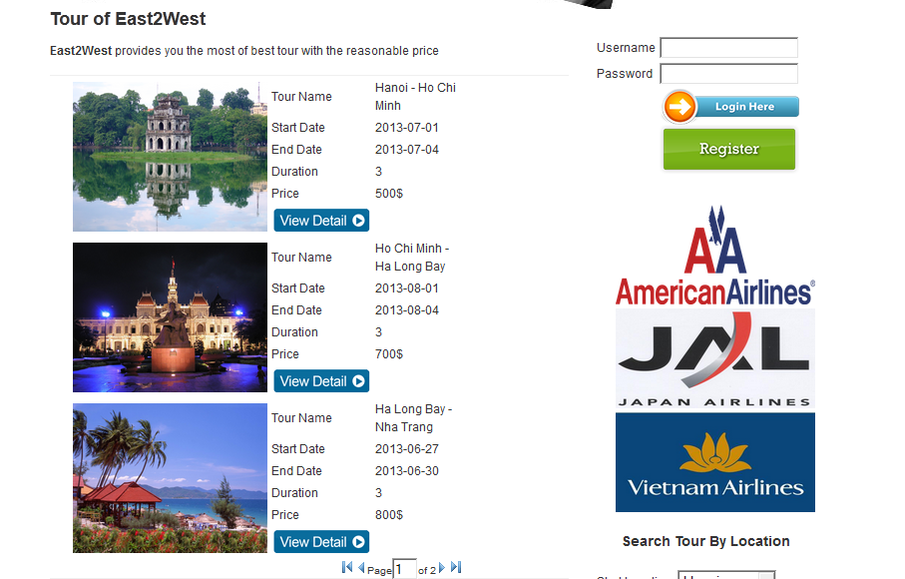
Tour page
Provides tour to customer

Slide 10
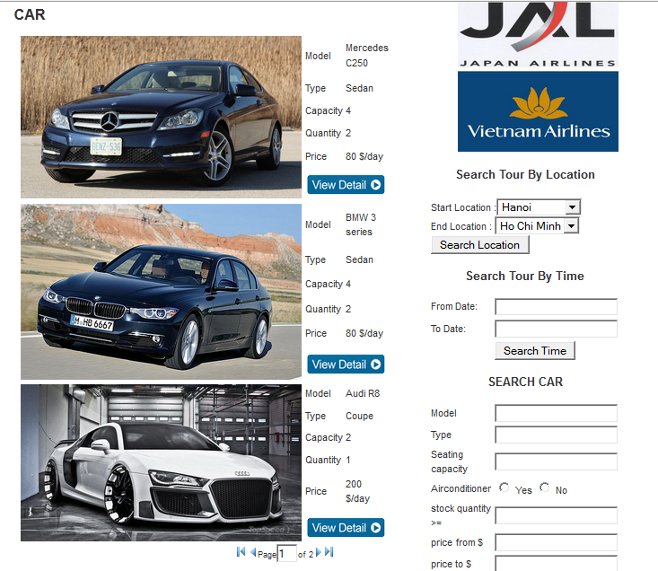
Car page
Provides car rent service for customer

Slide 11
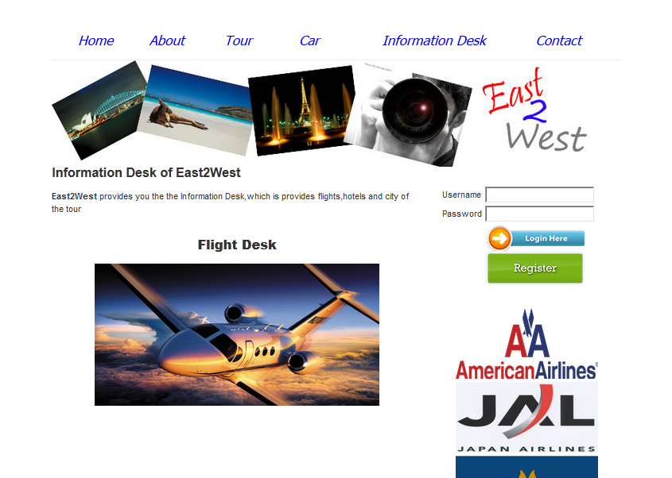
Information desk
Provides Flight information ,Hotel Information ,City Information for customer

